Slide 1
Cyclistic Membership
Presented by: Ayeishia Neal
Last Updated: October 15, 2025

Slide 2
Table of Contents
Business Task
Presenting the Data
Conclusion and Suggestions
Additional Steps

Slide 3
Business Task
How can we convert casual users to annual members?
Notes:
The company believes that the future success depends on maximizing the annual membership. So, to do this, we need to look at the users who are not annual members, the casual members, to figure out how they compare to the annual members and find the best way to reach them.

Slide 4
Now Let's Look At The Data
The following information is from the data between September 2024 and August 2025
Source: Divvy tripdata

Slide 5
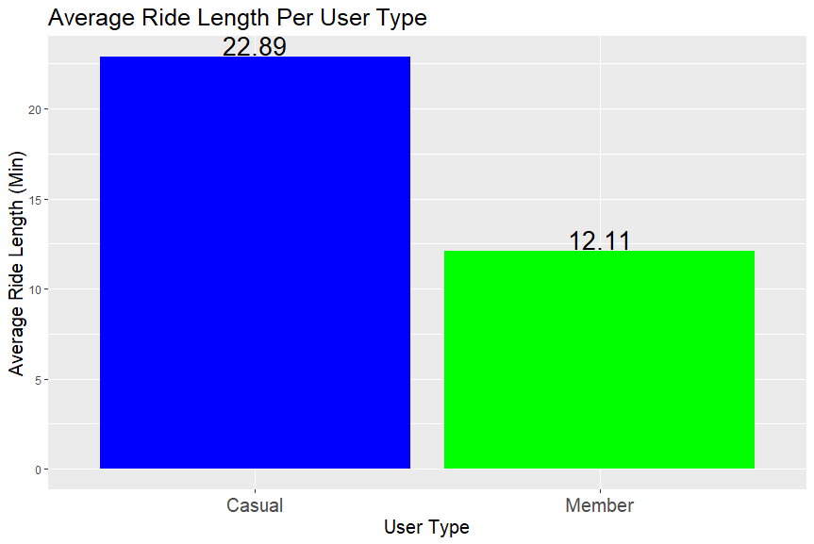
Average Ride Length in Minutes
On average, casual users ride 89% longer than annual members
We can capitalize on this by advertising promotions about how casual members can save money by becoming annual members
Notes:
Here we have the average ride length in minutes per user type over the past year. According to the data, casual members ride on average more than members. By having longer riding time, the marketing team can use this to advertise that they will save money from their rides over time.

Slide 6
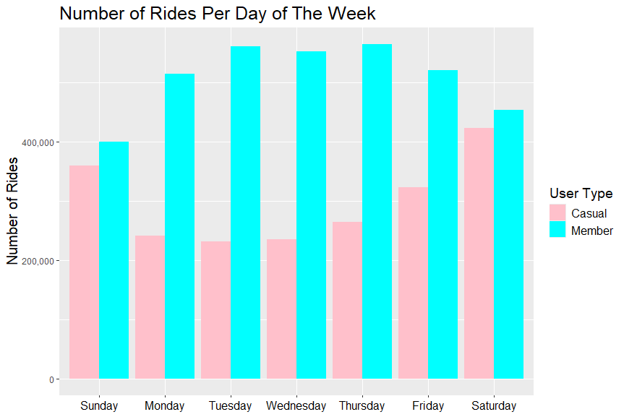
Number of Rides Per Day Over The Year
Friday, Saturday and Sunday are the popular weekdays for casual members
Tuesday, Wednesday, and Thursday are the popular weekdays for annual Members
With this information, we can advertise on these days to reach most of the casual members wit promotions, deals, and sales
Notes:
This charts shows the number of rides each day of the week casual members have over the course of the past year. As you can see, Saturday is the most popular with Sunday and Friday following. With this information, this will allow the marketing team to advertise annual memberships on these popular days.

Slide 7
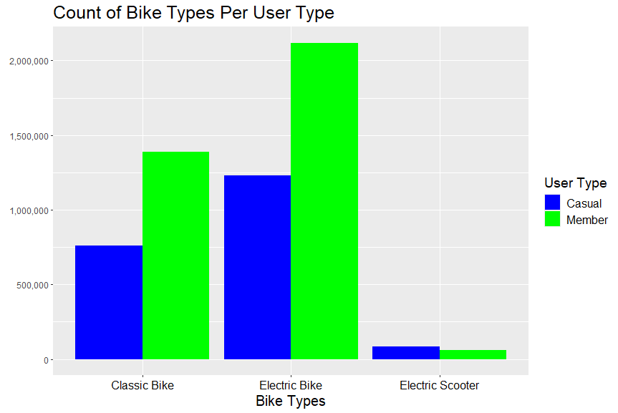
Bike Types
Electric bikes are the most popular for both user types
Creating promotions, discounts, and sales on electric bikes can help attract casual users to become annual members
Notes:
In this chart, we are looking at what bike types the casual members has chosen over the past year with electric bikes being the most popular. Since casual members gravitate the most to electric bikes, the marketing team can use this to plan out how to reach them or appeal to them. This could include creating promotions and discounts on this bike type if they purchase an annual membership.

Slide 8
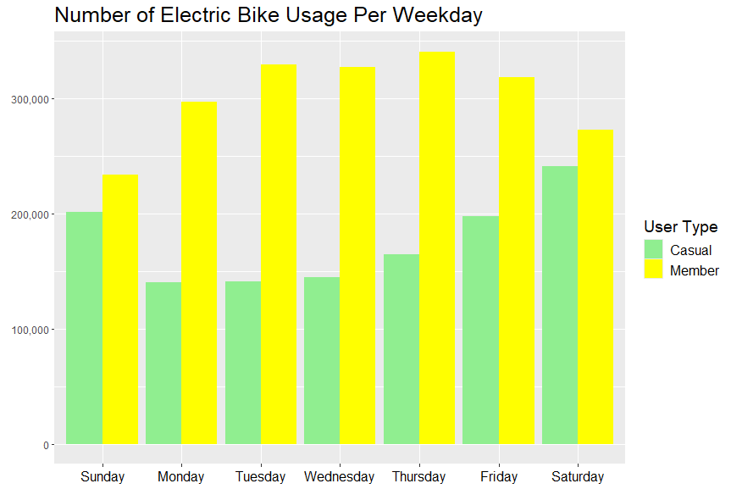
Electric Bike Usage Over The Weekday
The weekend is the most popular weekday for casual users to use electric bikes
Promoting deals and sales during this time can help annual membership conversion
Notes:
As per the last slide, we saw that electric bikes were the most popular amongst the users. Here, we can see when the users like to use the electric bikes throughout the week. Our team can use this information to figure out the best time to advertise to our members.

Slide 9
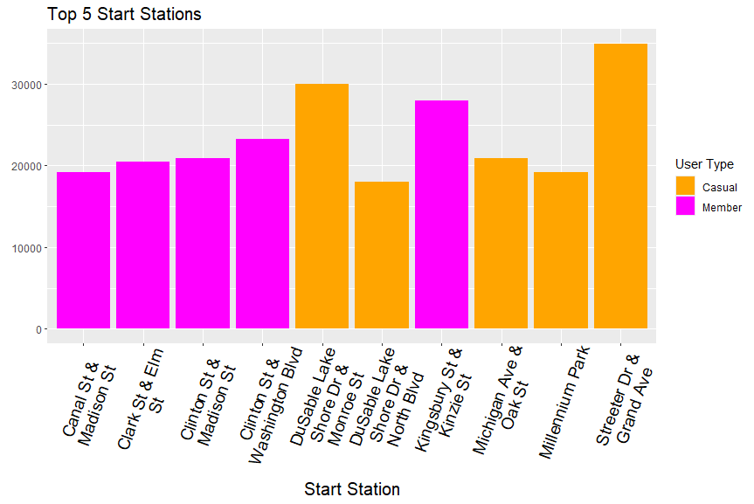
Top 5 Start Stations
The most popular start station for casual users is the Streeter Dr & Grand Ave station
The most popular start station for the annual members is the Kingsbury St & Kinzie St station
We can use this to target the stations that will reach more of the causal members
Promotions or discounts for certain stations throughout the week
These stations are either walking or a short transit trip away from each other
Notes:
Here, we are looking at the top 5 start stations. From this chart, we can see that “Streeter Dr & Grand Ave” station is the most popular start station for causal users and “Kingsbury St & Kinzie St” station for annual members. With this information, the marketing team can choose which start stations to place advertisements that will reach most of the casual users. Do note that this data has some rides that did not have a start station, so this is based off the rides that does provide a start station. Therefore, this chart is an estimate of the actual top 5 stations overall.

Slide 10
Conclusion and Suggestions
Casual users like to ride our electric bikes, on average, longer than our annual members during the weekend
Catering our advertisements to casual users by:
Showing how they can save money according to their average ride time if they purchase an annual membership
Taking advantage of the popular weekend days, bike types, and start stations by advertising via street signs around downtown Chicago or on the App
Promoting deals and sales at the popular start stations
Promoting deals and sales for electric bikes during the weekends
Plan events around the weekend starting at the Streeter Dr & Grand Ave station using electric bikes, which could be for annual members only to attract casual user conversions
Business Task: how can we convert casual users to annual members?

Slide 11
Additional Steps
Possible Next Steps
If There Was Additional Time
Monitor the number of annual memberships once advertisements roll out
Add survey questions about most wanted features in annual membership for retention
Analyze profit/revenue change from before and after advertisement/membership change
Find popular times of the day that casual members use our services
Analyze survey data to see what casual members are saying about the services
See if there is a relationship between holidays and bike trips

Slide 12
Thank you

